Slide 1
Early Muslims
by: Zainab Sajjad, Class-7B
Secondary Social Studies -SST

Slide 2
Outline
Abbasside Dynasty
Introduction
Q/A
The Crusades
Introduction
Q/A
Affects of Crusades and Muslim Rule
Introduction
Q/A
Summary
Home-work

Slide 3
Abbasid Dynasty
Period: 8th century (750–1258)
Founded Capital City: Baghdad in Iraq
Two famous rules: 1. Haroon-al-Rashid, 2. Mamoon
Abbasid period is commonly known as the “Age of Wealth and Culture”
Flourished in Mathematics, Science and Arts

Slide 4
Q/A
Which was the capital of Abbasid Empire:
Baghdad
Damascus
Kufah
Makkah
Who is the predecessor of Abbasid Empire:
Ottoman
Mughals
Ottomans
Ummaid

Slide 5
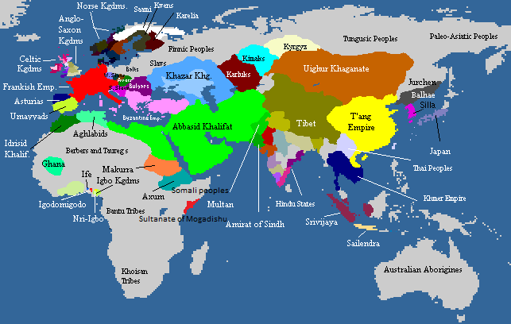
Abbasid Dynasty
Map of Abbasid empire and other world empires in 9th century

Slide 6
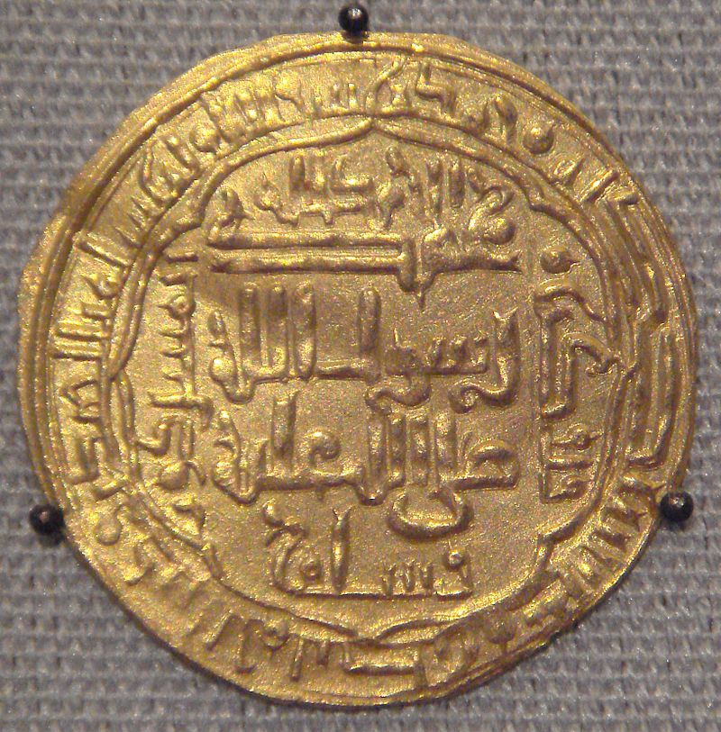
Abbasid Dynasty
Coin of the Abbasids, Baghdad, 1244

Slide 7
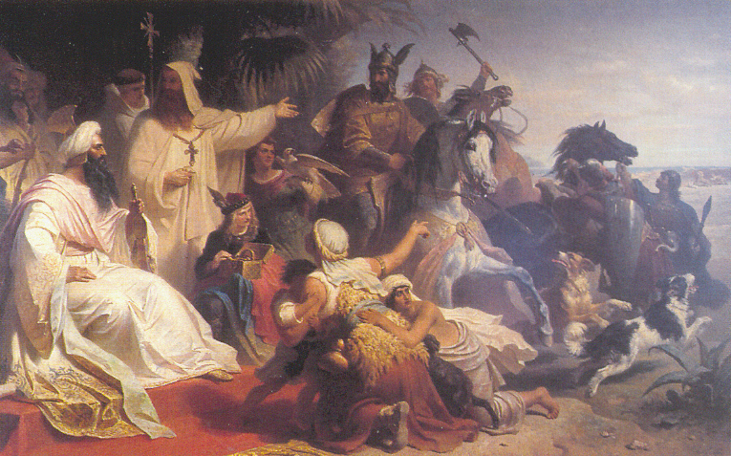
Abbasid Dynasty
Harun al-Rashid receiving a delegation sent by Charlemagne at his court in Baghdad. Painting by German painter Julius

Slide 8
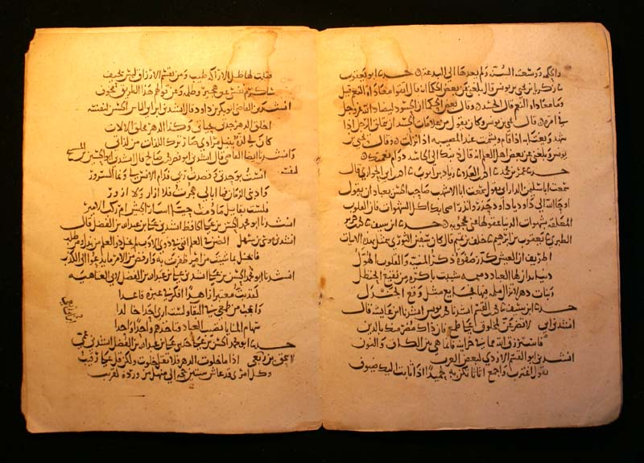
Abbasid Dynasty
Manuscript from the Abbasid era

Slide 9
The Crusades
The crusades were a series of religious wars between European Christians and Muslims.
Crusades are Christian European invaders
Invaded the Muslim world: 11th – 13th century
Famous Muslim Leader of this Era: Salahuddin Al-Ayubi (1174-93)
Recapitulated Jerusalem in 1188
Ruled Egypt and Syria

Slide 10
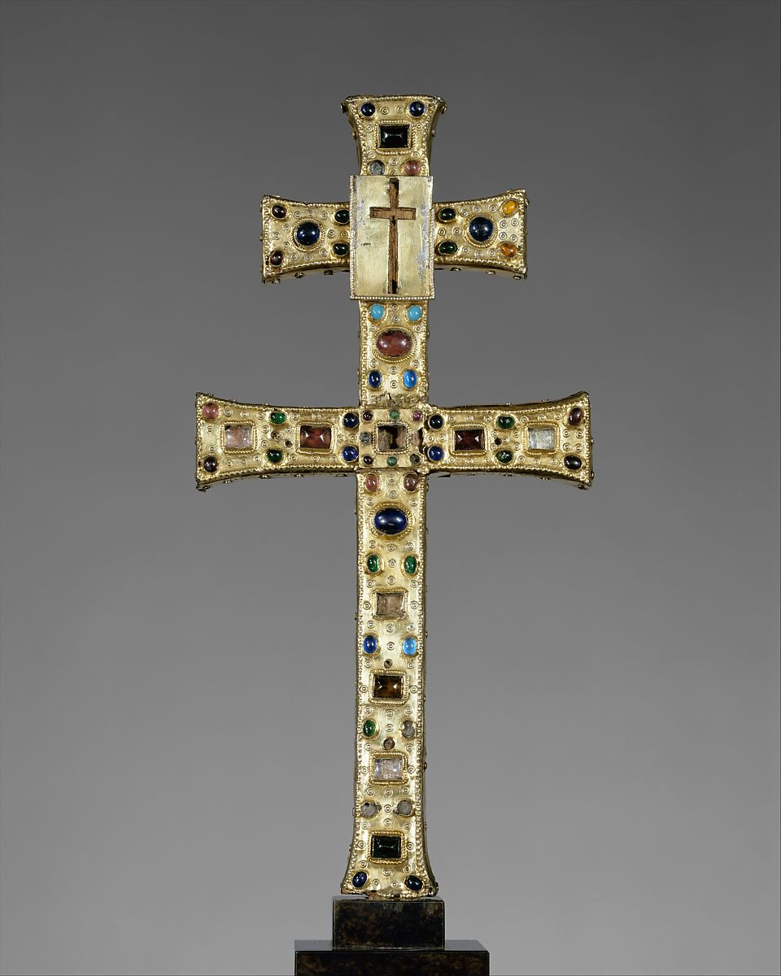
The Crusades
The Crusades Symbol

Slide 11
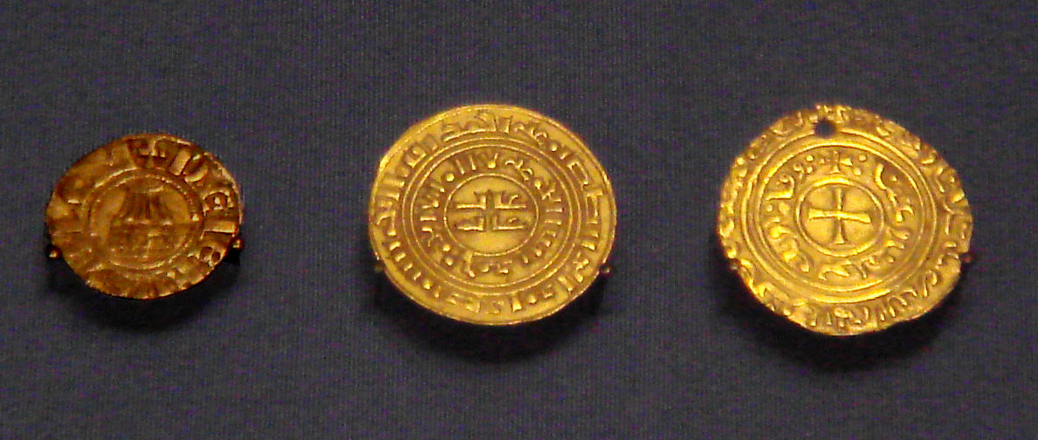
The Crusades
Crusader coins of the Kingdom of Jerusalem. Left: Denier in European style with Holy Sepulchre (1162–75). Centre: Kufic gold bezant (1140–80). Right: gold bezant with Christian symbol (1250s). (British Museum)

Slide 12
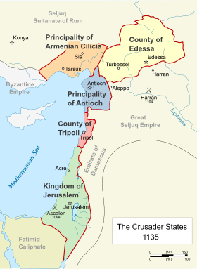
The Crusades
The Crusader States in 1135

Slide 13
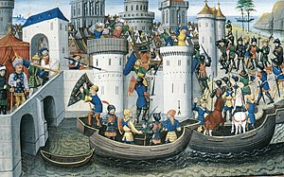
The Crusades
Conquest of the Orthodox city of Constantinople by the crusaders in 1204 (BNF Arsenal MS 5090, 15th century)

Slide 14
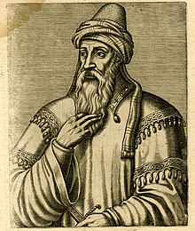
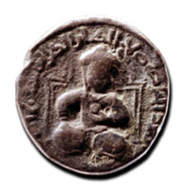
Salahuddin
Saladin as depicted on a dirham coin, c. 1190
A possible portrait of Saladin by André Thevet, c. 1584

Slide 15
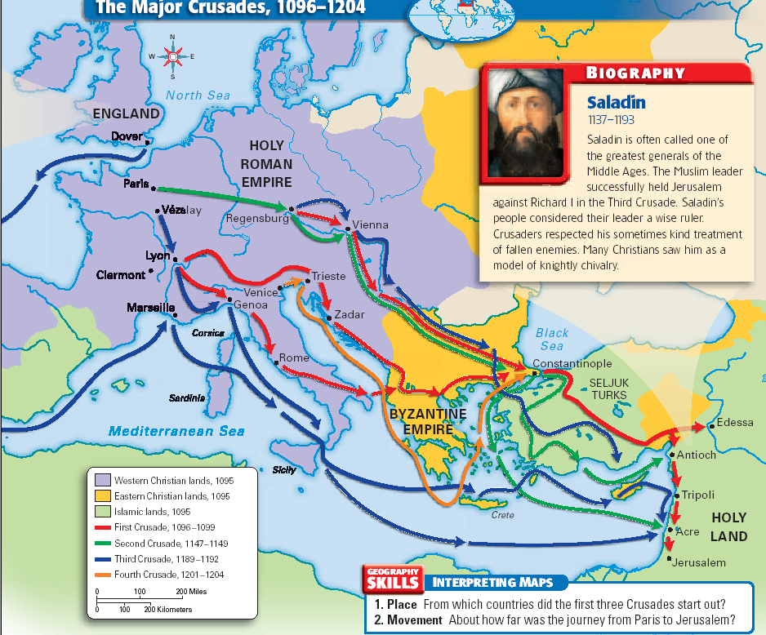
Salahuddin
History of Crusades and Saladin

Slide 16
Q/A
The crusades began as
Jewish efforts to reclaim Palestine.
Muslim efforts to reclaim Iberia.
Christian efforts to reclaim Jerusalem.
efforts by all groups to convert non-believers.
What Muslim group brought an end to the Byzantine Empire?
Mongols
Mughals
Ottomans
Seljuks

Slide 17
Affects of Crusades and Muslim Rule
Exchange of Science and Culture
Muslims and Europeans learned each others knowledge and ideas
European learned cartography, use of compass and astrolabe navigation
There were exchange of trade for various species between Europeans and Arabs

Slide 18
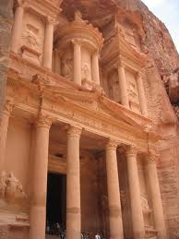
Affects of Crusades and Muslim Rule
It renewed interest in Classical culture.
Ancient Roman art, architecture, etc. forgotten in the Dark Ages (medieval times), were seen by traveling soldiers and brought back to Europe.

Slide 19
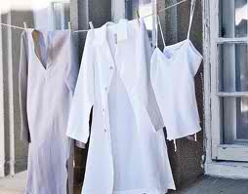
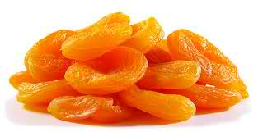
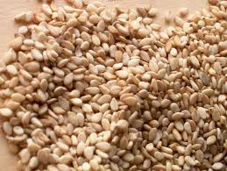
Affects of Crusades and Muslim Rule
Contact with Eastern Cultures:
As knights moved through Constantinople and the Holy Land, they learned of new foods, clothing, and ways of doing things that they brought back to Europe with them.
Some of these goods were: Apricots, rice, cotton cloth, and sesame seeds.

Slide 20
Q/A
How were Muslims affected by the crusades?
Many earned money by trading with Europeans.
Muslims often had their property destroyed.
Muslims began to keep permanent armies.
All of the above
How did the crusades affect Jews?
Many Christians converted to Judaism.
Many Jews left Europe and went to Palestine.
Jews were persecuted throughout Europe.
Jews joined Christians to fight Muslims.

Slide 21
Home-Work
Write 1-2 line answers to following questions:
Write three historical achievement of Salahuddin Ayubi.
What are Crusades?
What are the famous rulers of the Abbasid dynasty?
What are technological benefits Muslims captured from Europeans?
What are the major knowledge learned by European?
What was the important trade between after crusades and Muslim rules?
Collect the historical was names and pictures from Abbasid and Crusades fights
Collect the pictures of the heroes of these era

Slide 22
Thanks

